Slide 1
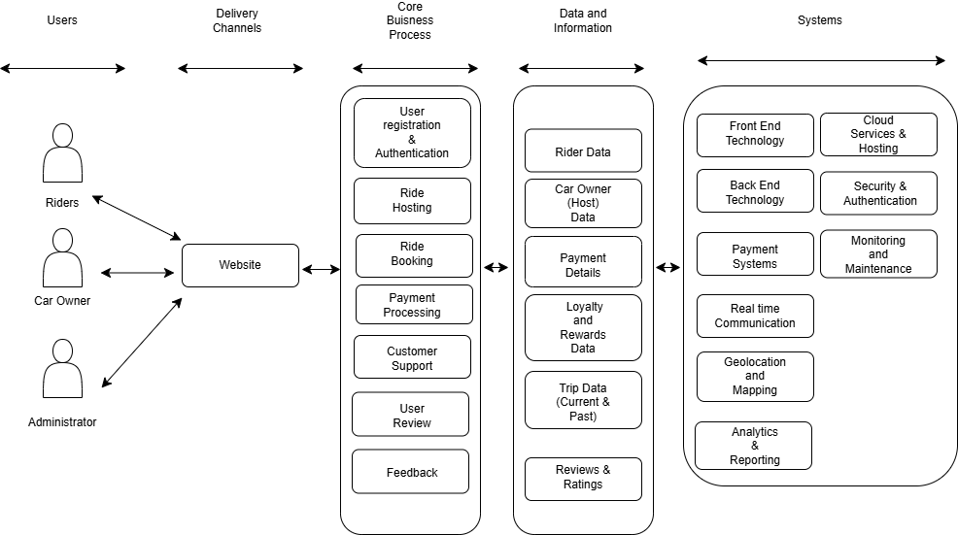
Application: RideEase
Type: Application Architecture
View: Logical View
Style: Layered Architecture Pattern

Slide 2
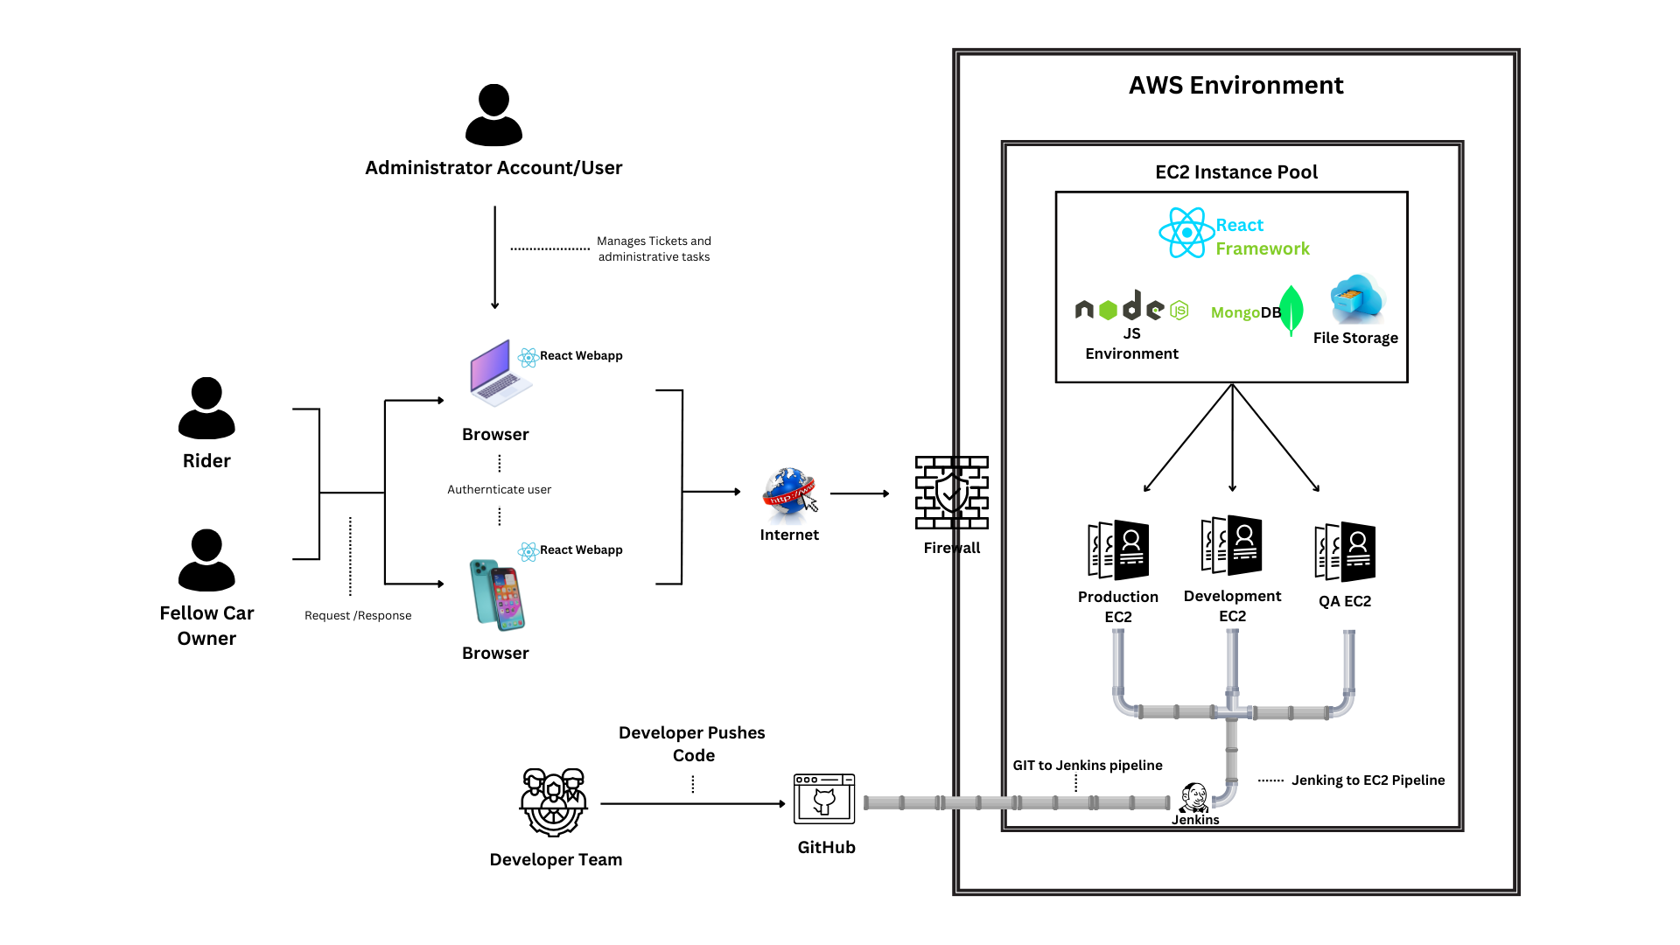
Application: RideEase
Type: Application Architecture
View: Process View
Style: Layered Architecture Pattern

